Slide 1

ACCESS MY PHONE
A Project Presentation by: -
Rohit Thaosen
Tareni Nayak
Dattatraya Deb
Govind Yadav
Under the Guidance of
Prof. Suresh Chandra Moharana
School of Computer Engineering
KIIT Deemed to be University, Bhubaneswar, Odisha- 751024

Slide 2
INTRODUCTION
“Access My Phone” is based on the Safety and Security of our “Smart Phones”. Suppose a Phone Admin/user due to his/her carelessness loses his/her phone, then through this App, he/she can remotely retrieve the details of the device and perform necessary operations on it from other Phone without the use of “INTERNET”.
You might have thought that our App is very similar to “Find my Phone” by Google. But this app by Google requires Internet and has only few functions but for our App to run and send necessary details to the User
operating from other phone, it doesn’t need any net.

Slide 3
INTRODUCTION (cont.)
We can perform many functionalities from this Application like retrieving the Device ID of phone, receiving the contacts from my Phone to the other Phone, receive my Phone GPS coordinates, Ring or Vibrate a Device, Screen Lock a Device. Well for the security purpose, we have a PIN Authentication which can only be accessed by the admin.
The 2 more important aspect of our Application is that All this Operations can be performed simply through SMS with no Internet and also the App need not be installed in the Other Phone from where I am trying to Access my Phone. See, How Simple is it, right? So much major operations can be performed through very simple procedures which even an amateur Phone user can do.
This is what we Computer Science Engineers strive for “Simplicity”, “Efficiency” and “User Friendly Lifestyle”.

Slide 4
Tools Used in our Project: -
1. Android Development Studio
2. Java 8
3. Lucid Chart
4. Smart Draw
5. Microsoft Word
6. Microsoft Powerpoint

Slide 5
ABSTRACT
Phone Tracking and Remote Phone Access Applications are recently rising in Demand now-a days.
It mainly focuses on the safety, security and tracking of Devices.
During times of emergency, we can perform emergency operations remotely from the phone.
This Application can be mainly used by Police Department for Tracking and other Investigation purposes.
Such Applications can save an user’s huge loss of money and sensitive data if he/she gets back access to the Device Again.
Even this app can be a good example for Monitoring system if you don’t have the Device in your nearby vicinity.
This Application is basically a Minor Project made by 4 students under a project Guide from KIIT Deemed to be University, Bhubaneswar for the 6th Semester.
Such Development of Applications are especially focussed on making Human Lifestyle more flexible, efficient and less Effort.
We as Engineers always keeps up the priority to take on such Projects which emphasizes on Eradication of Daily Real Life Problems and thereby take a great step in improving the quality of Human Lifestyle.

Slide 6
Requirement Analysis
The inputs to the process include the user’s requirements and the project constraints. The requirements are to be successfully transformed into designs within the constraints. The constraints to adhere with are devices having a minimum version of software version and the availability of network over which messages can be sent and received.
In this project, the following types of requirements are to be fulfilled:
• User requirements – This includes extracting data from their device with the application installed, through another device remotely, and also making the device perform certain tasks. And the user always has to use a PIN to perform this action.

Slide 7
Requirement Analysis (cont.)
The type of data to be extracted are:
o Contacts
o Location
o Device ID
The actions to be performed by the device after receiving PIN:
o Set or change the PIN
o Change sound profile to ring/vibrate
o Lock screen
• Operational requirements –
o The device must be running at the least Android version 8.
o Phone should be switched on and should be in a network
coverable area.

Slide 8
OBJECTIVE
Access My Phone is a Device Tracking and Remote Device Controlling Android Application developed on Android Studio.
The Major Objectives of this Application is: -
1. It mainly focuses on helping an user to access his/her phone when it’s not in his/her nearby vicinity.
2. He/she can track the location of the phone and perform many other necessary operation(SOS) on his/her phone remotely from another Phone.
3. The App Solely focuses on Human Friendly Approach keeping in mind the level of Professionalism in using the Phone.
4. We have developed the Application on the principle of SMS or Text Message Service System and also no need of Internet.

Slide 9
Objective (cont.)
Our Plan: -
1. The Application will have an Encrypted PIN.
2. If any user wants to access the phone from other phone, he/she will have to access the phone through PIN Encryption first.
3. The App must have the Services Started in order to carry out the important tasks.
4. The user can send SMS from the Other Phone to the Host Phone where the App is Installed.
5. In the SMS, he/she will have to type simple cammands according to the requirements and send it to the Admin/ Host Phone.
6. The Host Phone will verify the Pin and the service status.
7. After Verifying those in Step 6, the App will verify the syntax of the command. If the commands are
correct, the App will do the following operations: -
a. Sending the Device ID of the Phone.
b. Sending Contact Numbers(if availble) from the Host Phone to the Other Phone.
c. Random PIN Generation, Updating it and sending it to the host Phone or to a specified Number.
d. Changing Host Phone to Ring or Vibrate Mode.
e. Locking the Screen of the Phone
f. Send the Current GPS Coordinate of the Phone

Slide 10
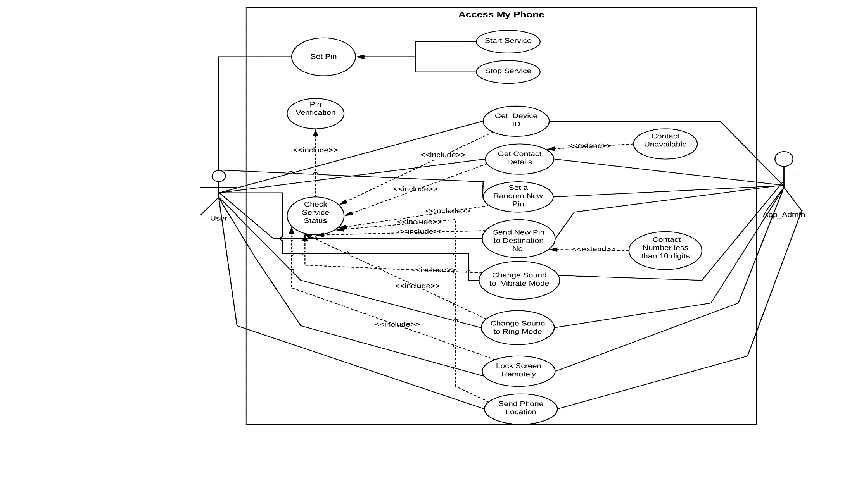
System Design
Use Case Diagram

Slide 11
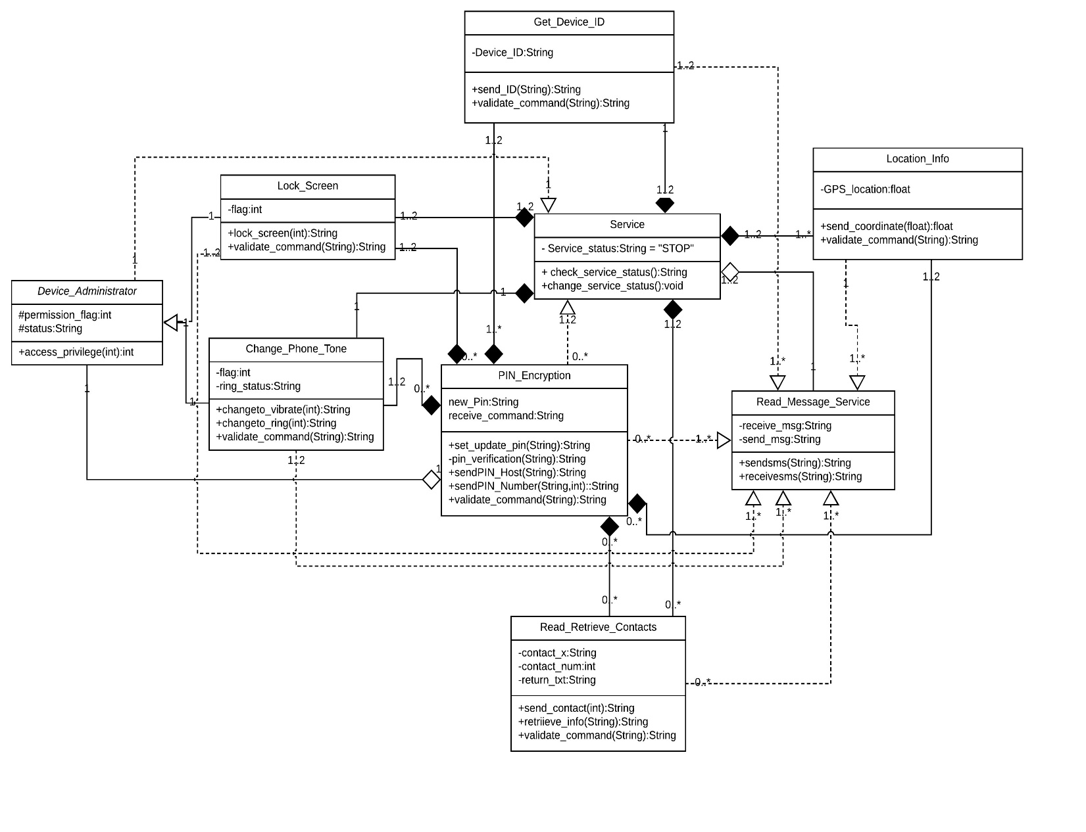
Class Diagram

Slide 12
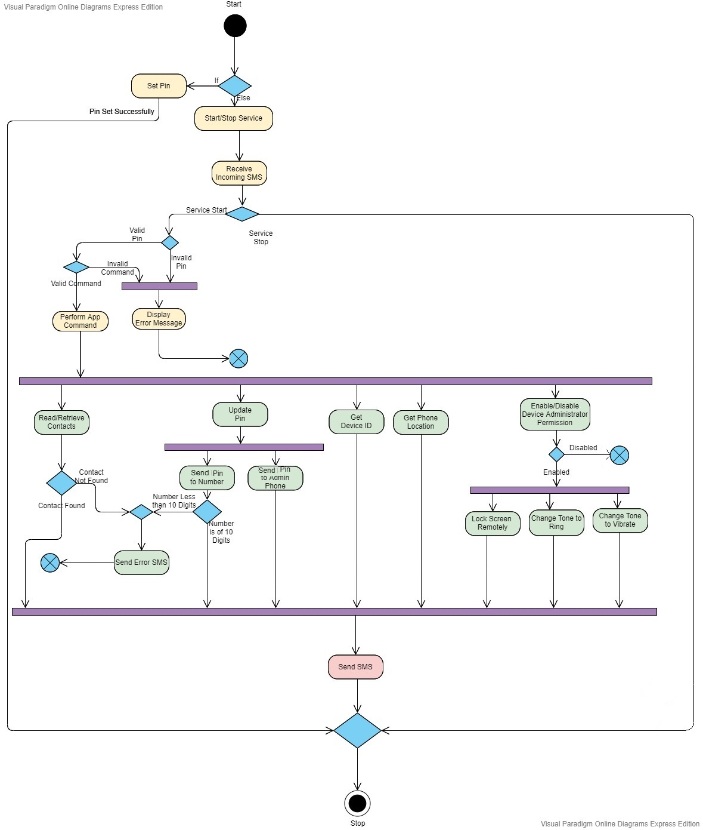
Activity Diagram

Slide 13
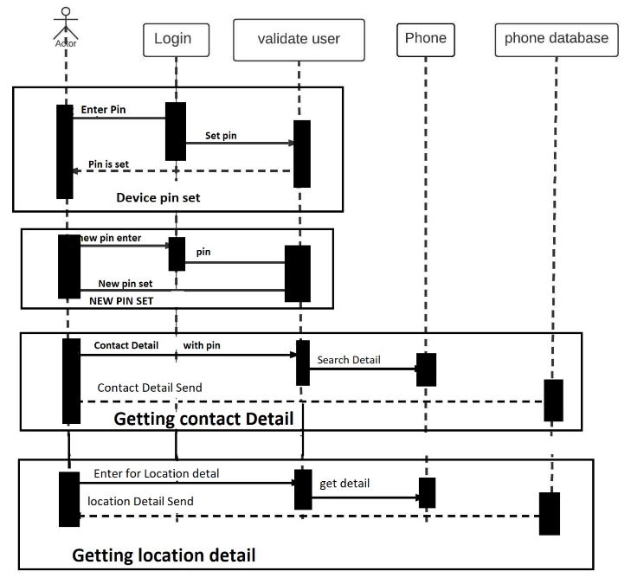
Sequence Diagram

Slide 14
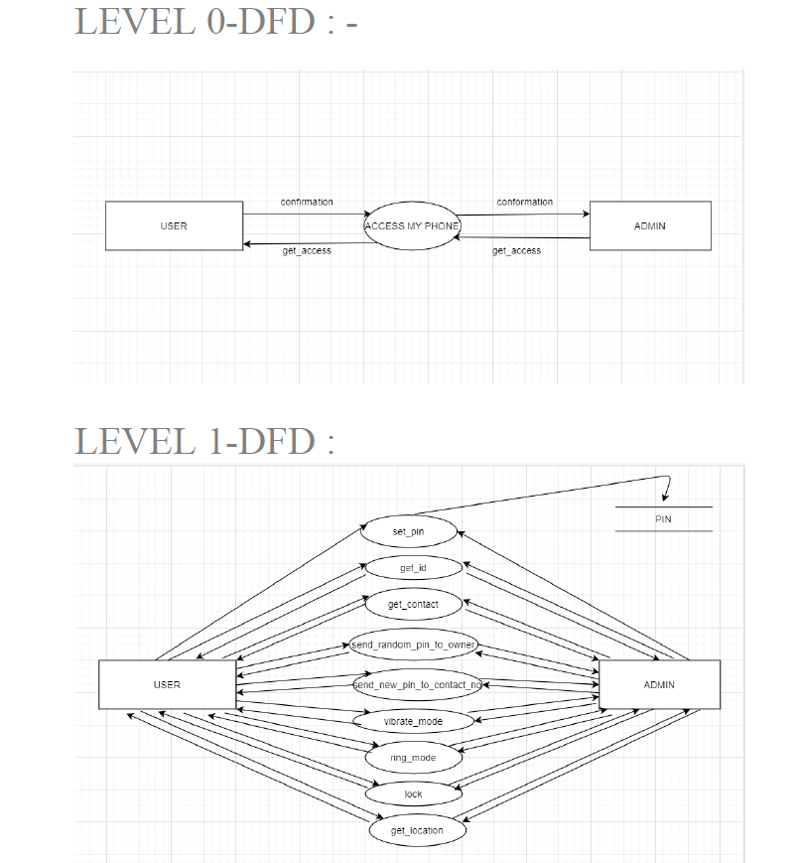
Data Flow Diagram

Slide 15
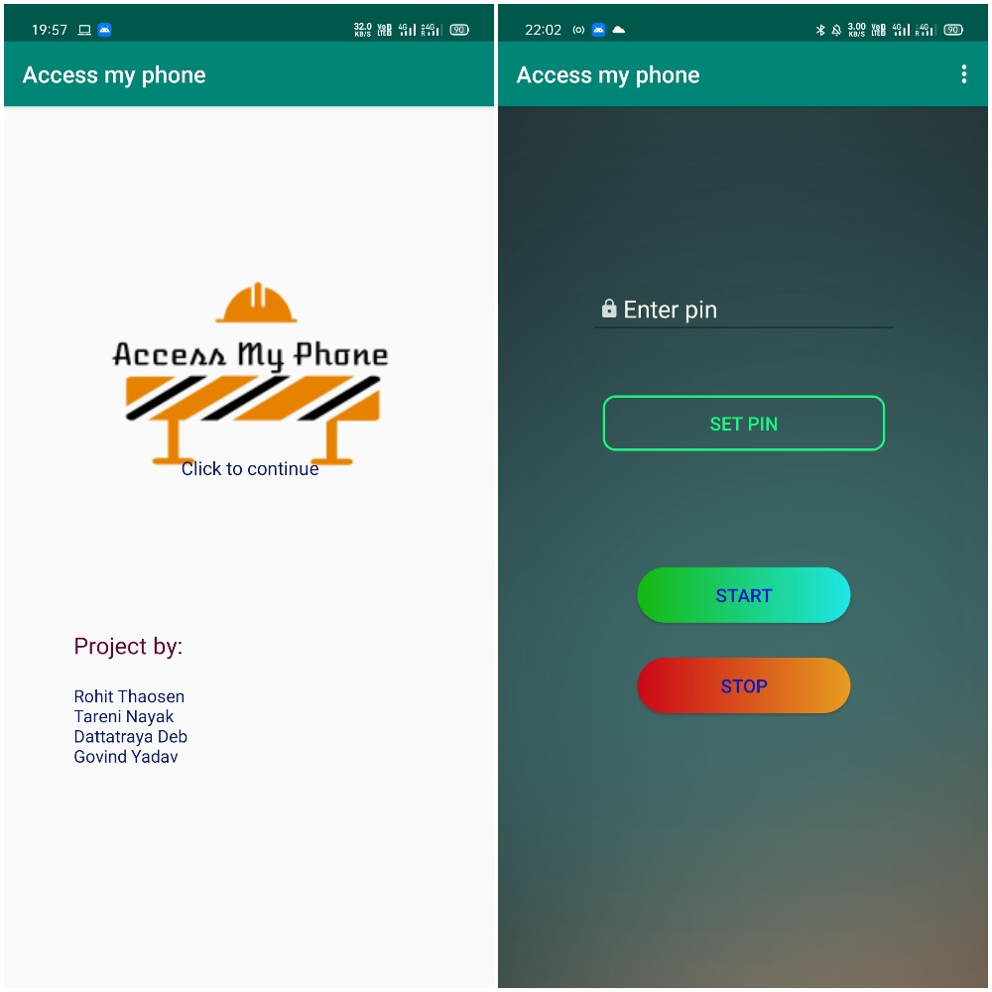
App. Interface

Slide 16
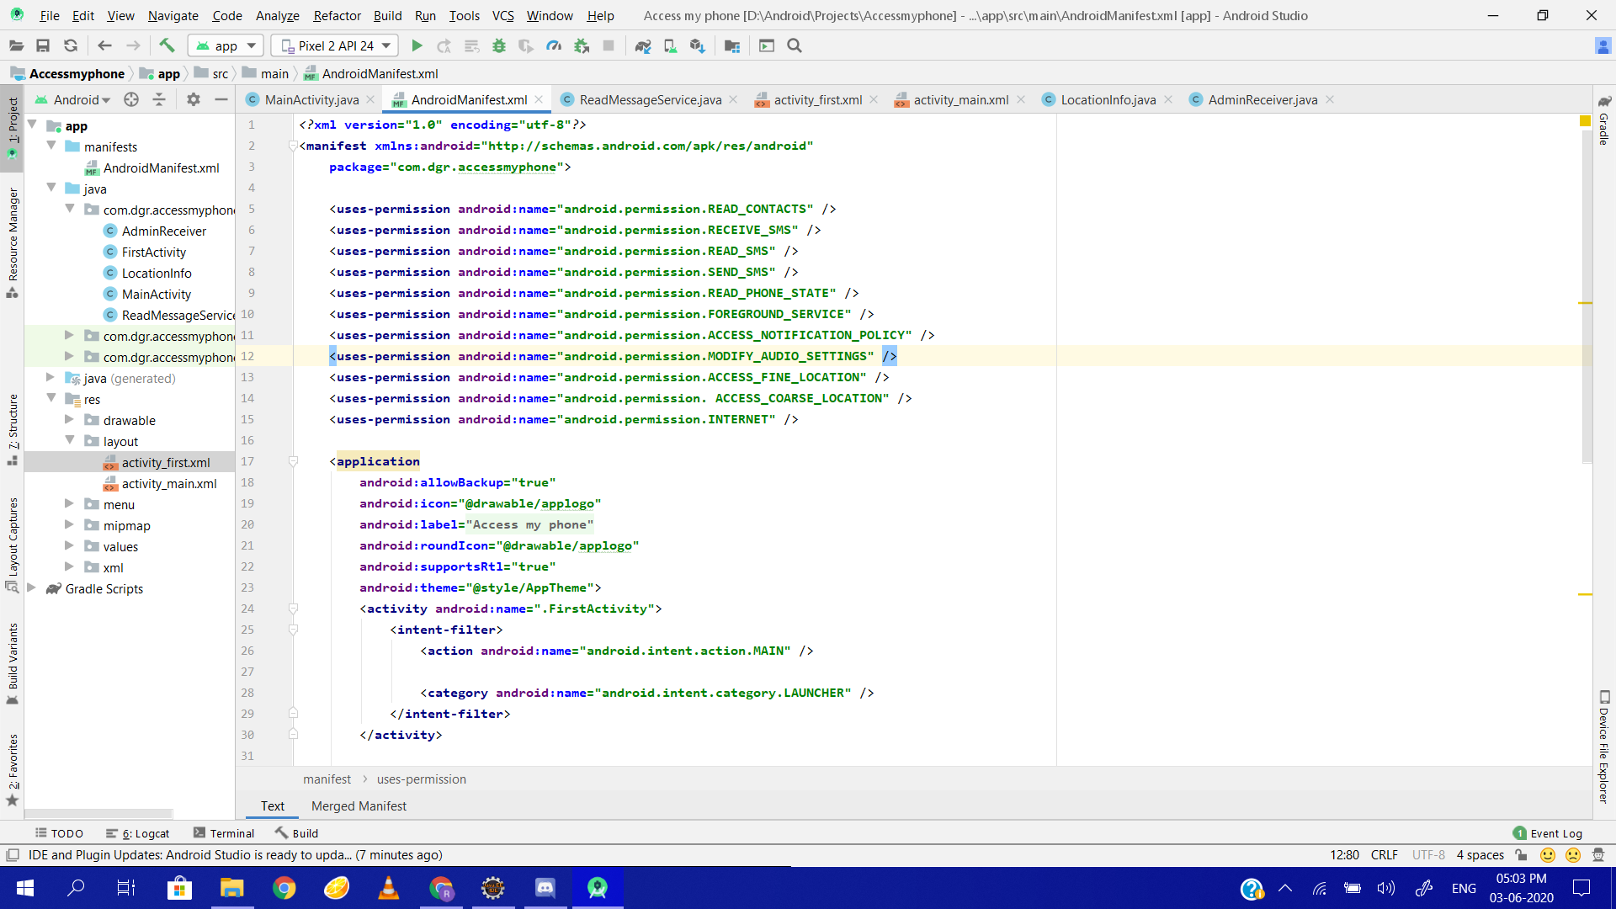
SCREENSHOT OF THE CODE

Slide 17
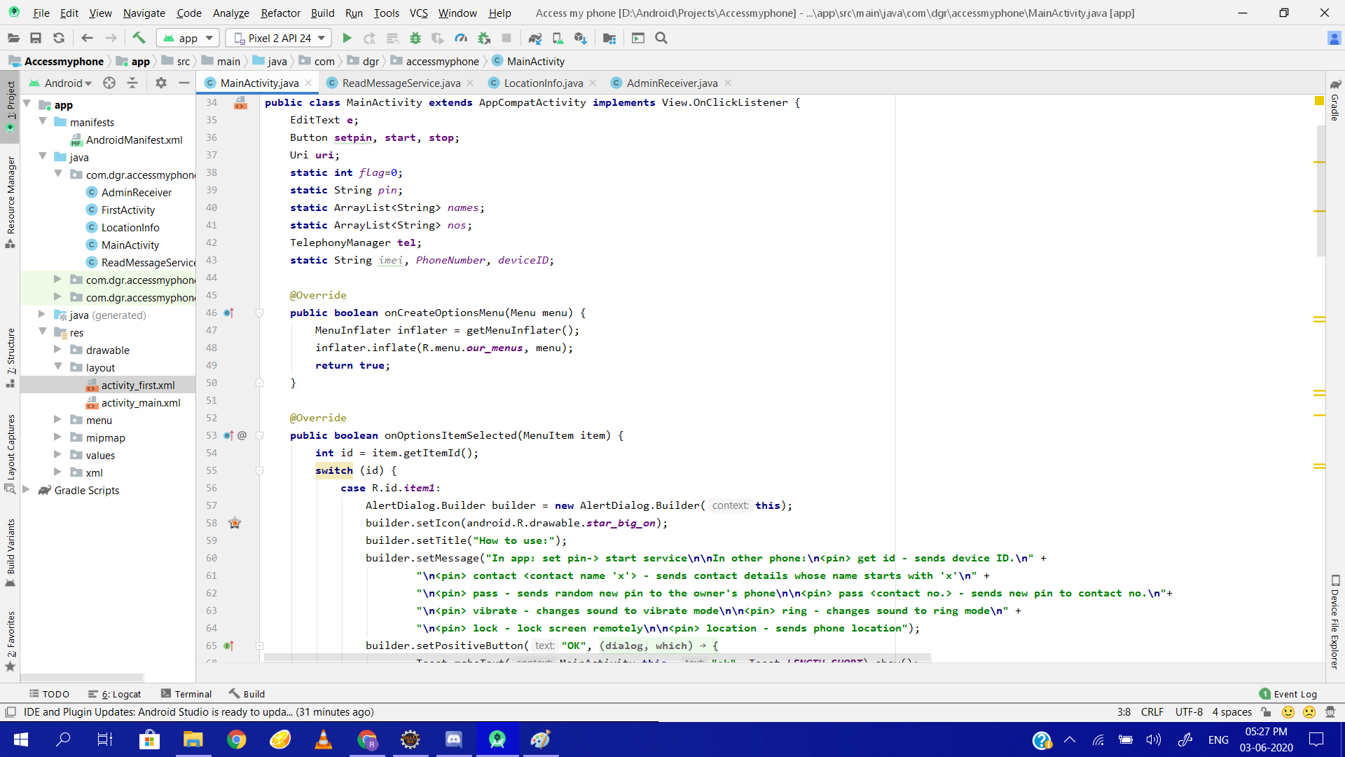
MainActivity

Slide 18
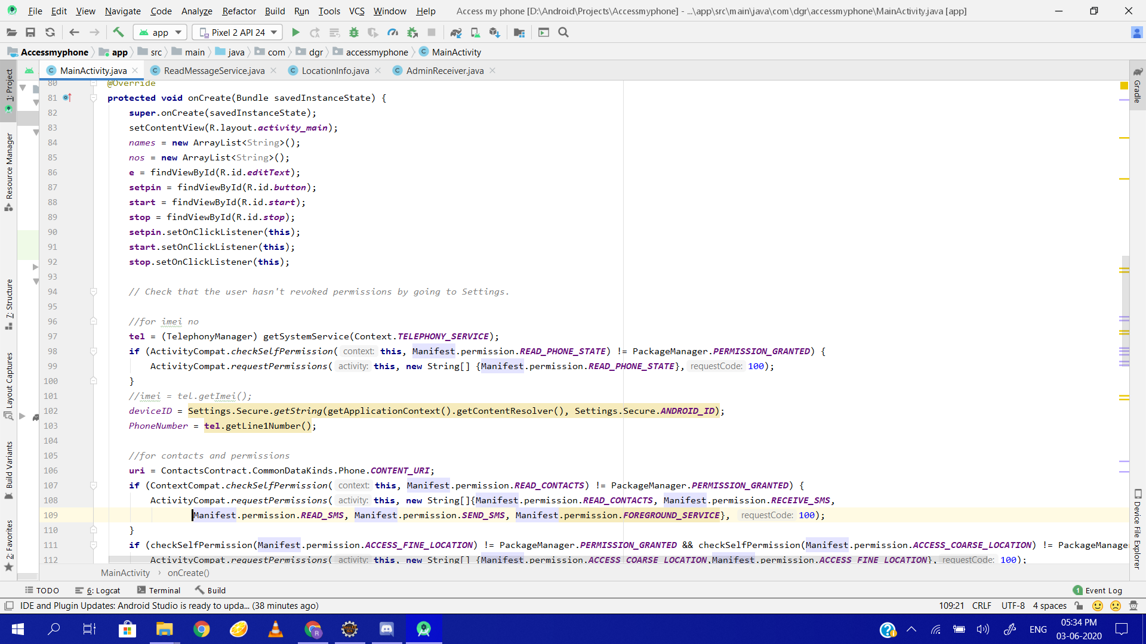
continue...

Slide 19
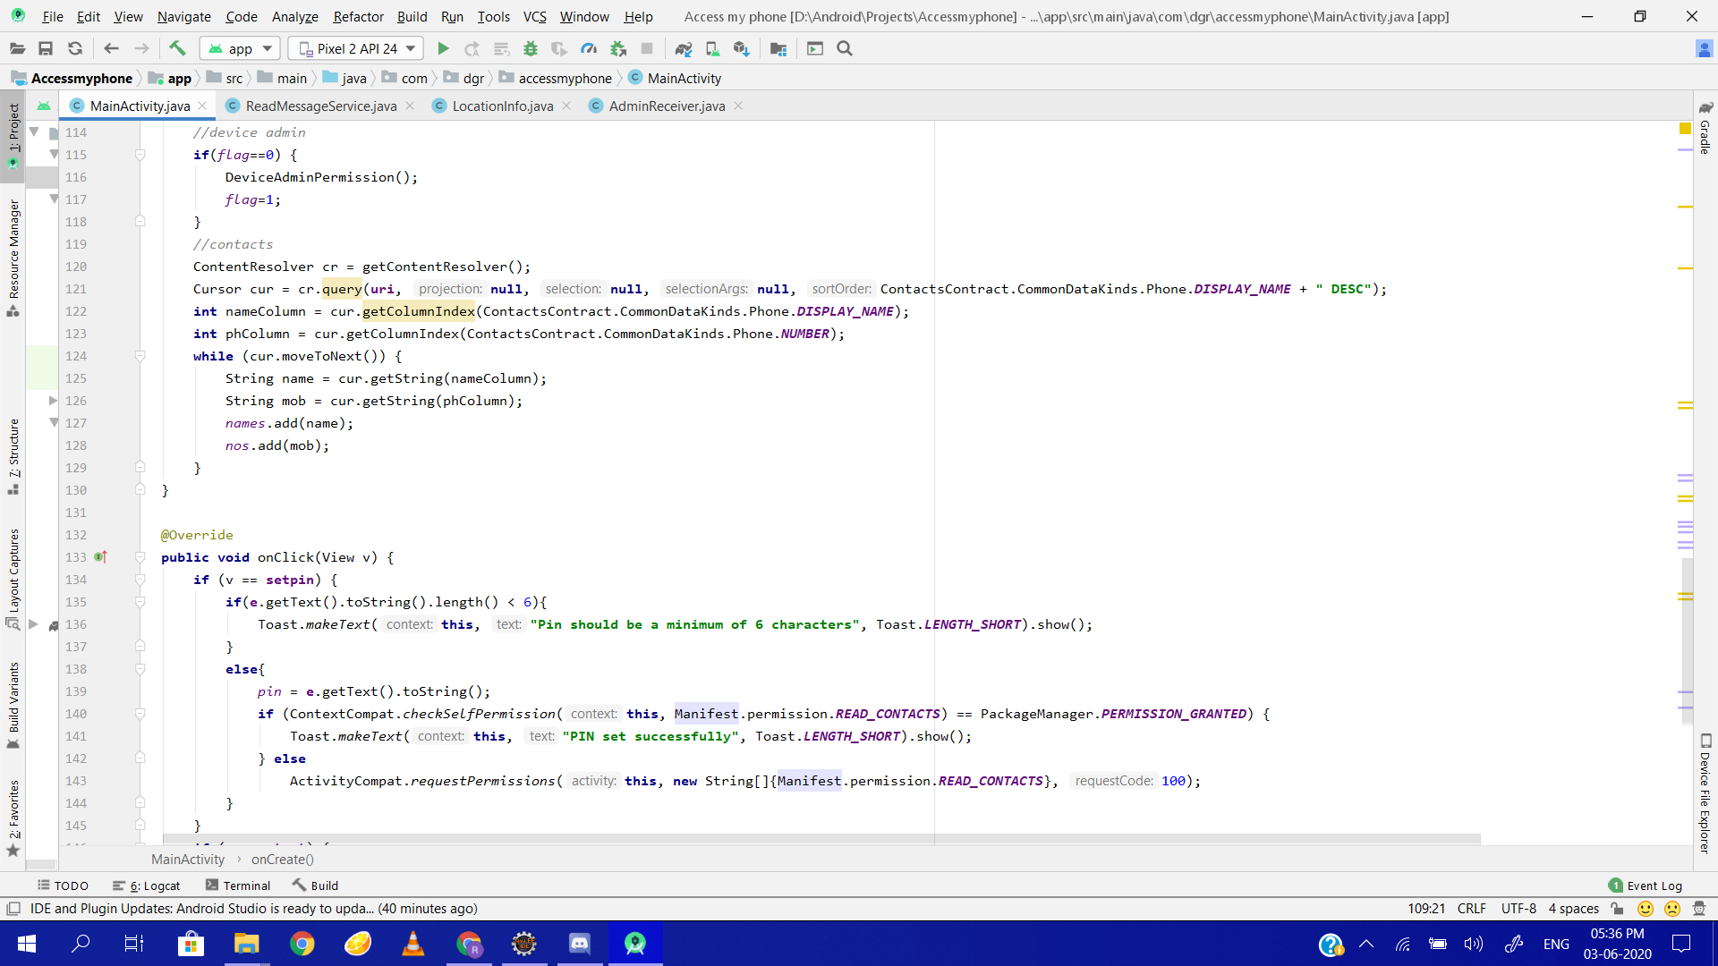
continue...

Slide 20
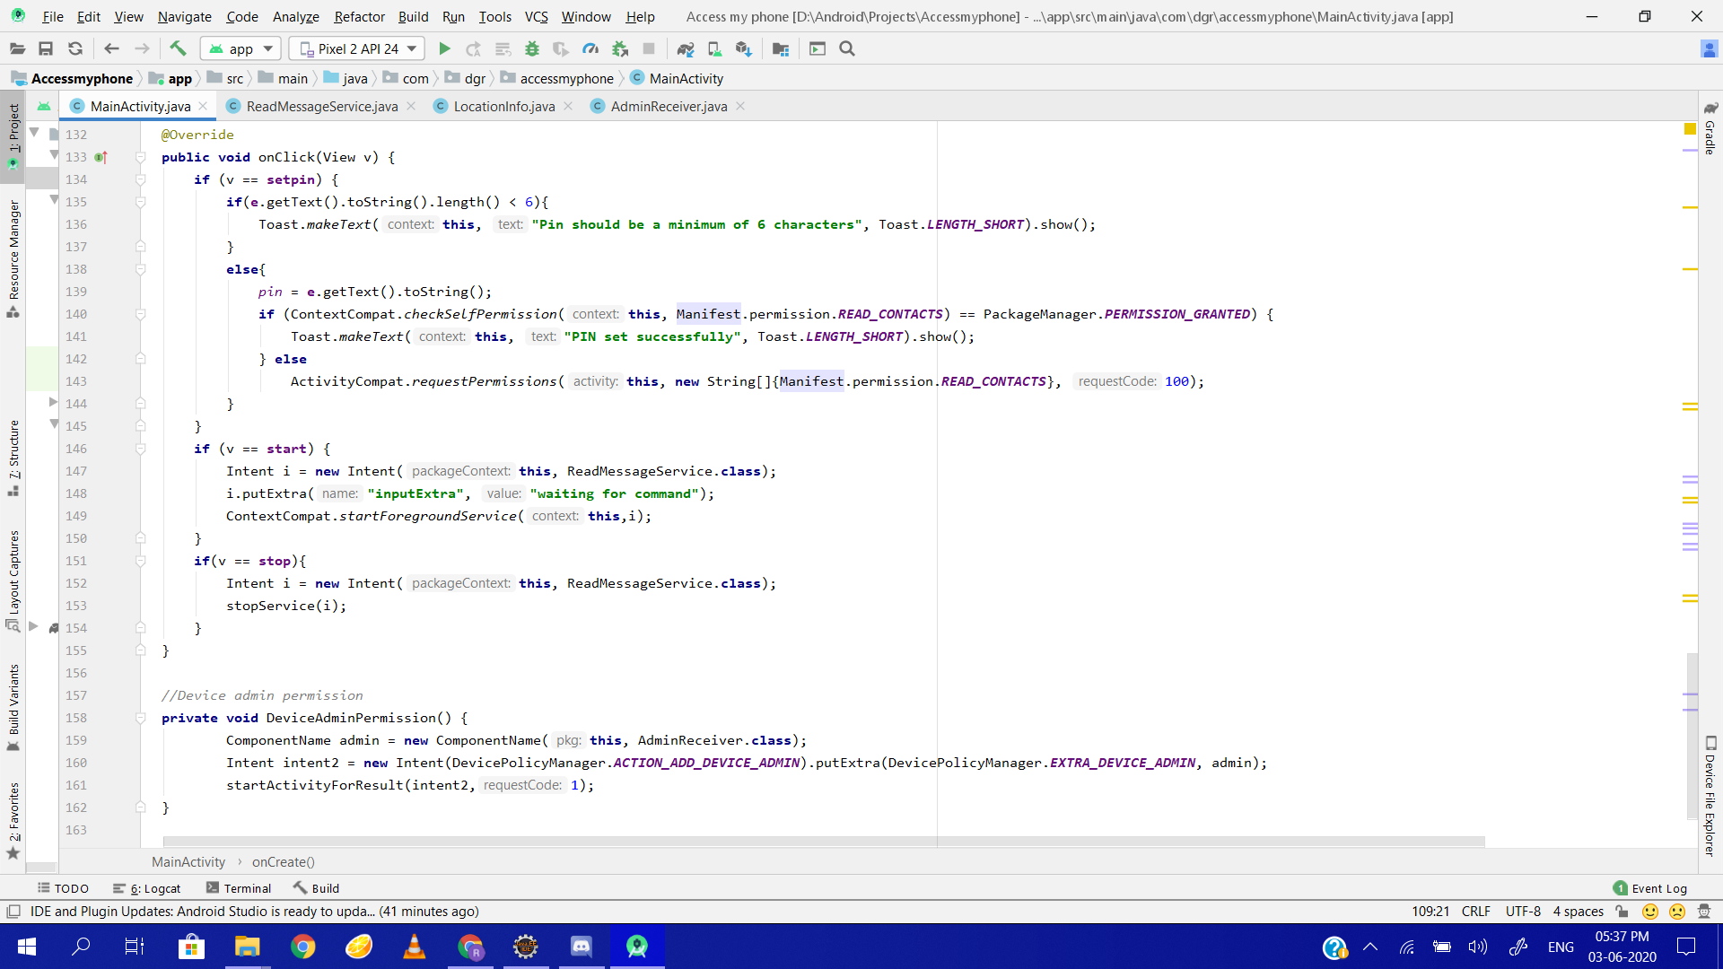
continue...

Slide 21
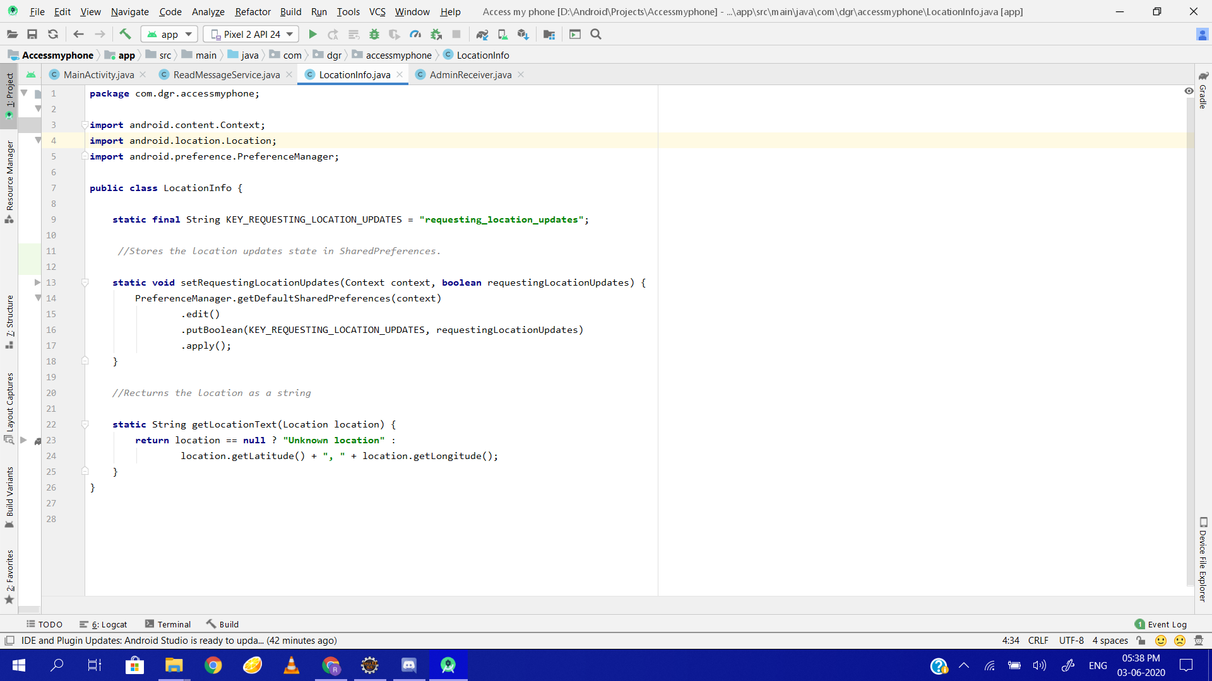
LOCATION INFO

Slide 22
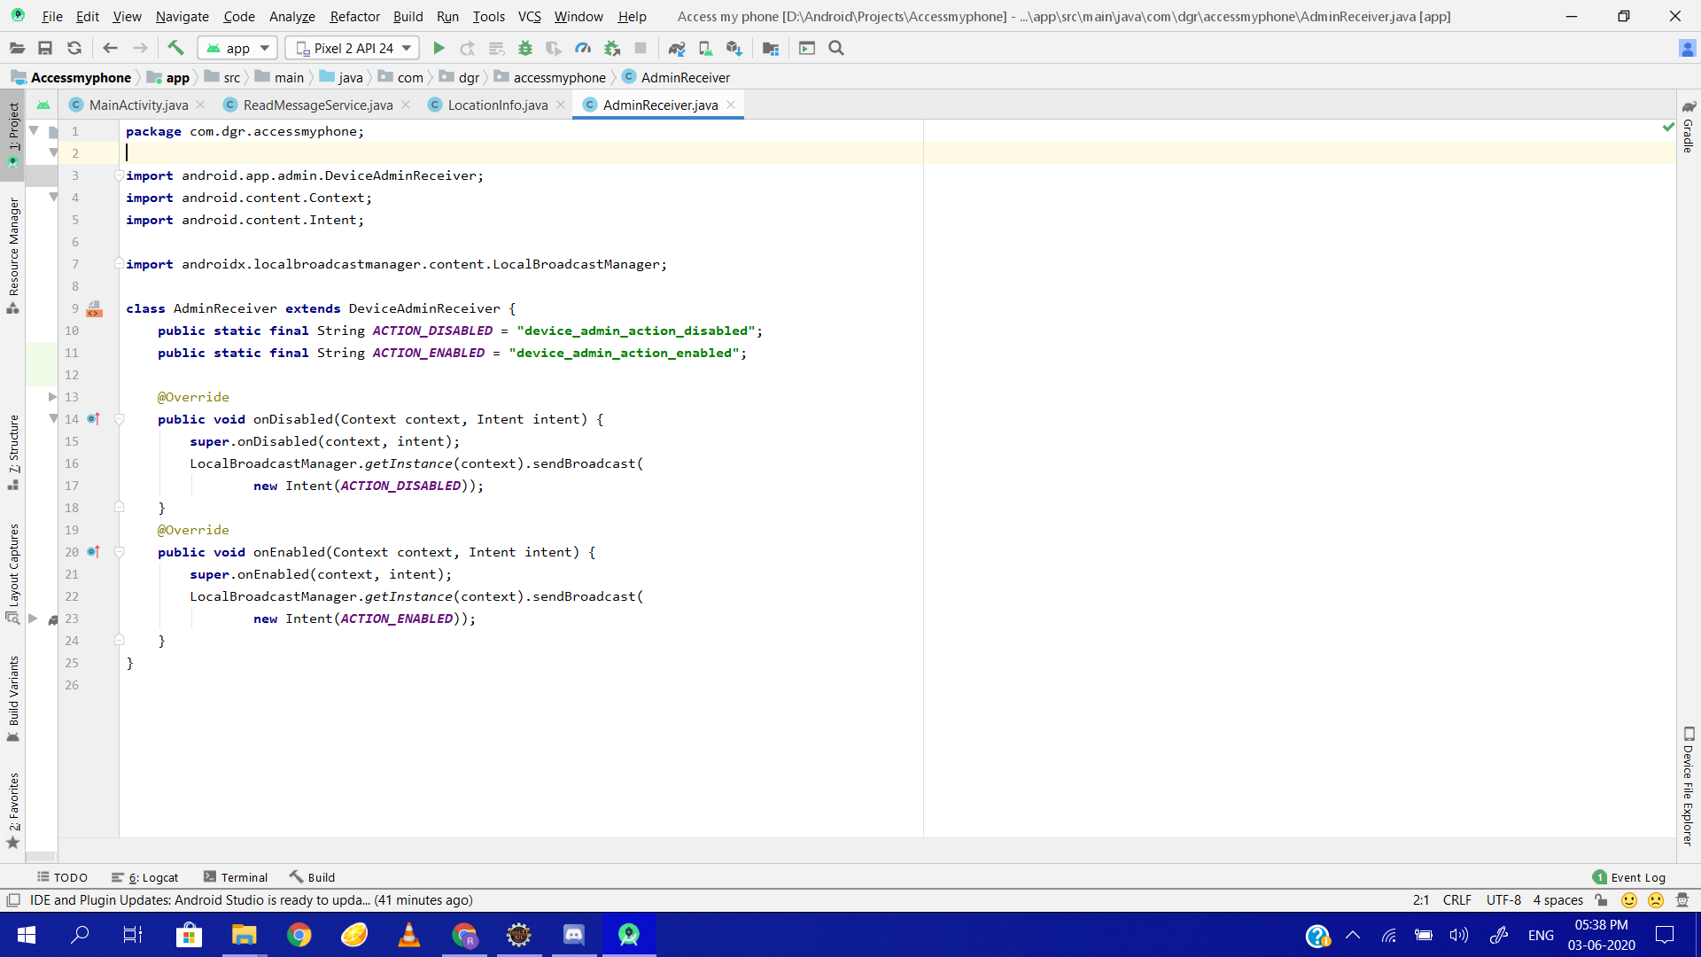
DEVICE ADMIN REQUEST

Slide 23
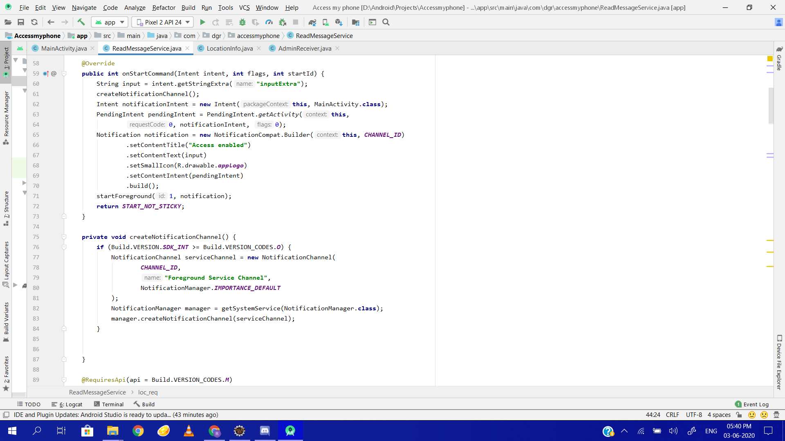
READ MESSAGE

Slide 24
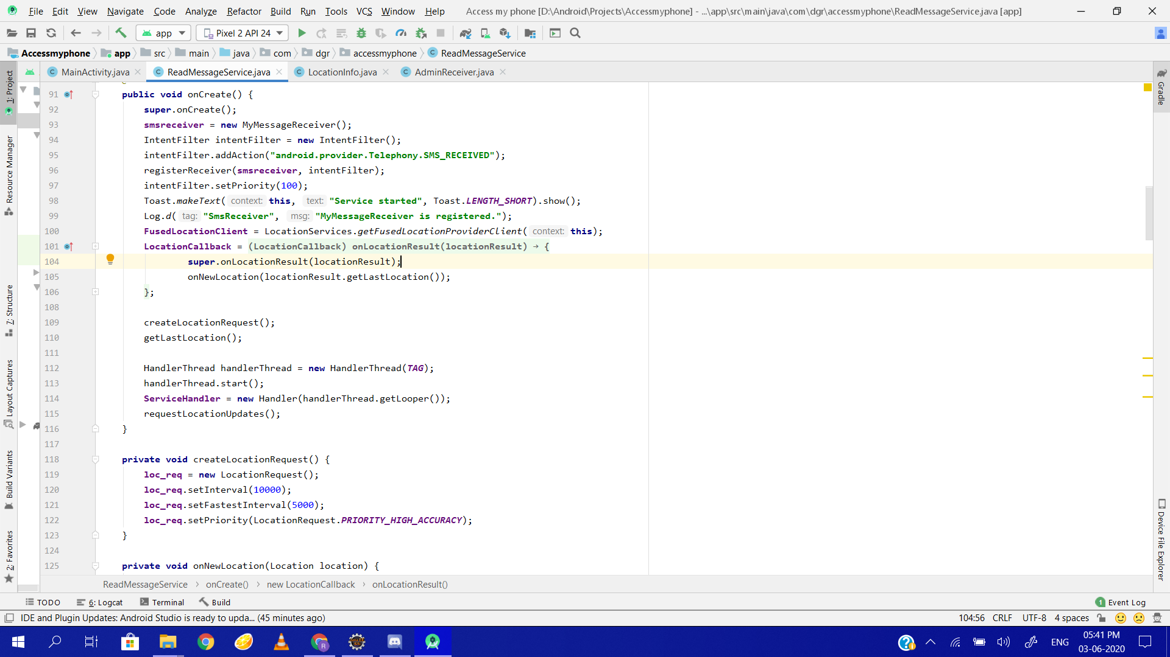
continue...

Slide 25
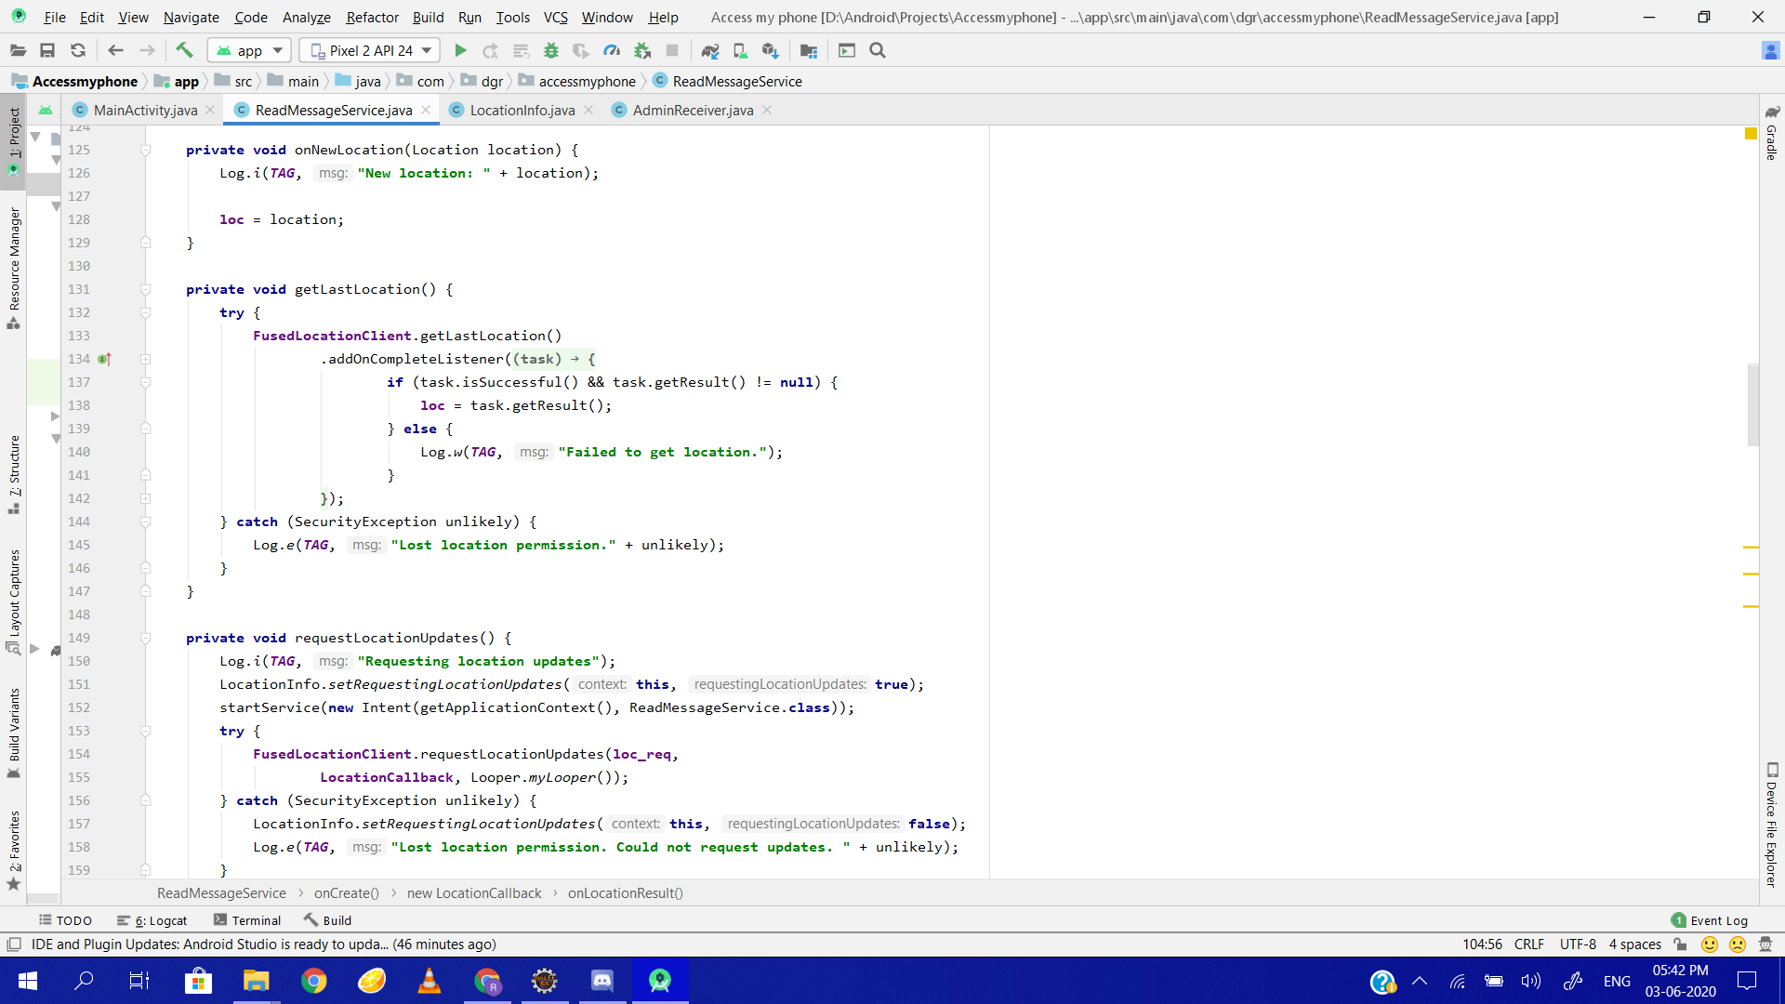
continue...

Slide 26
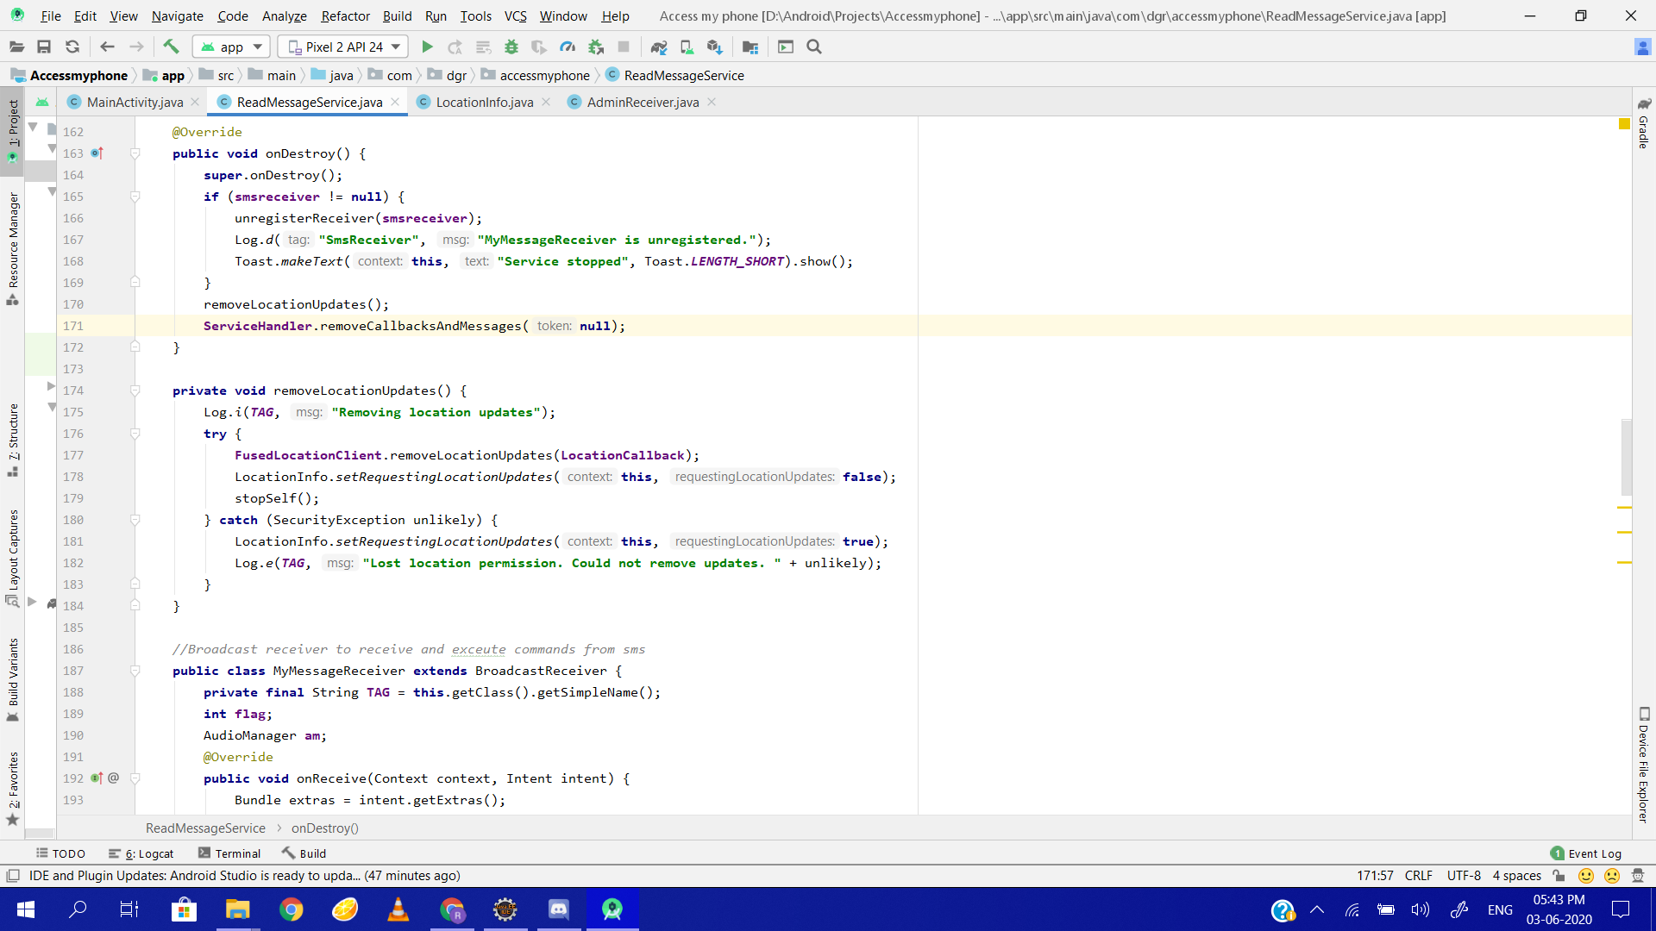
continue....

Slide 27
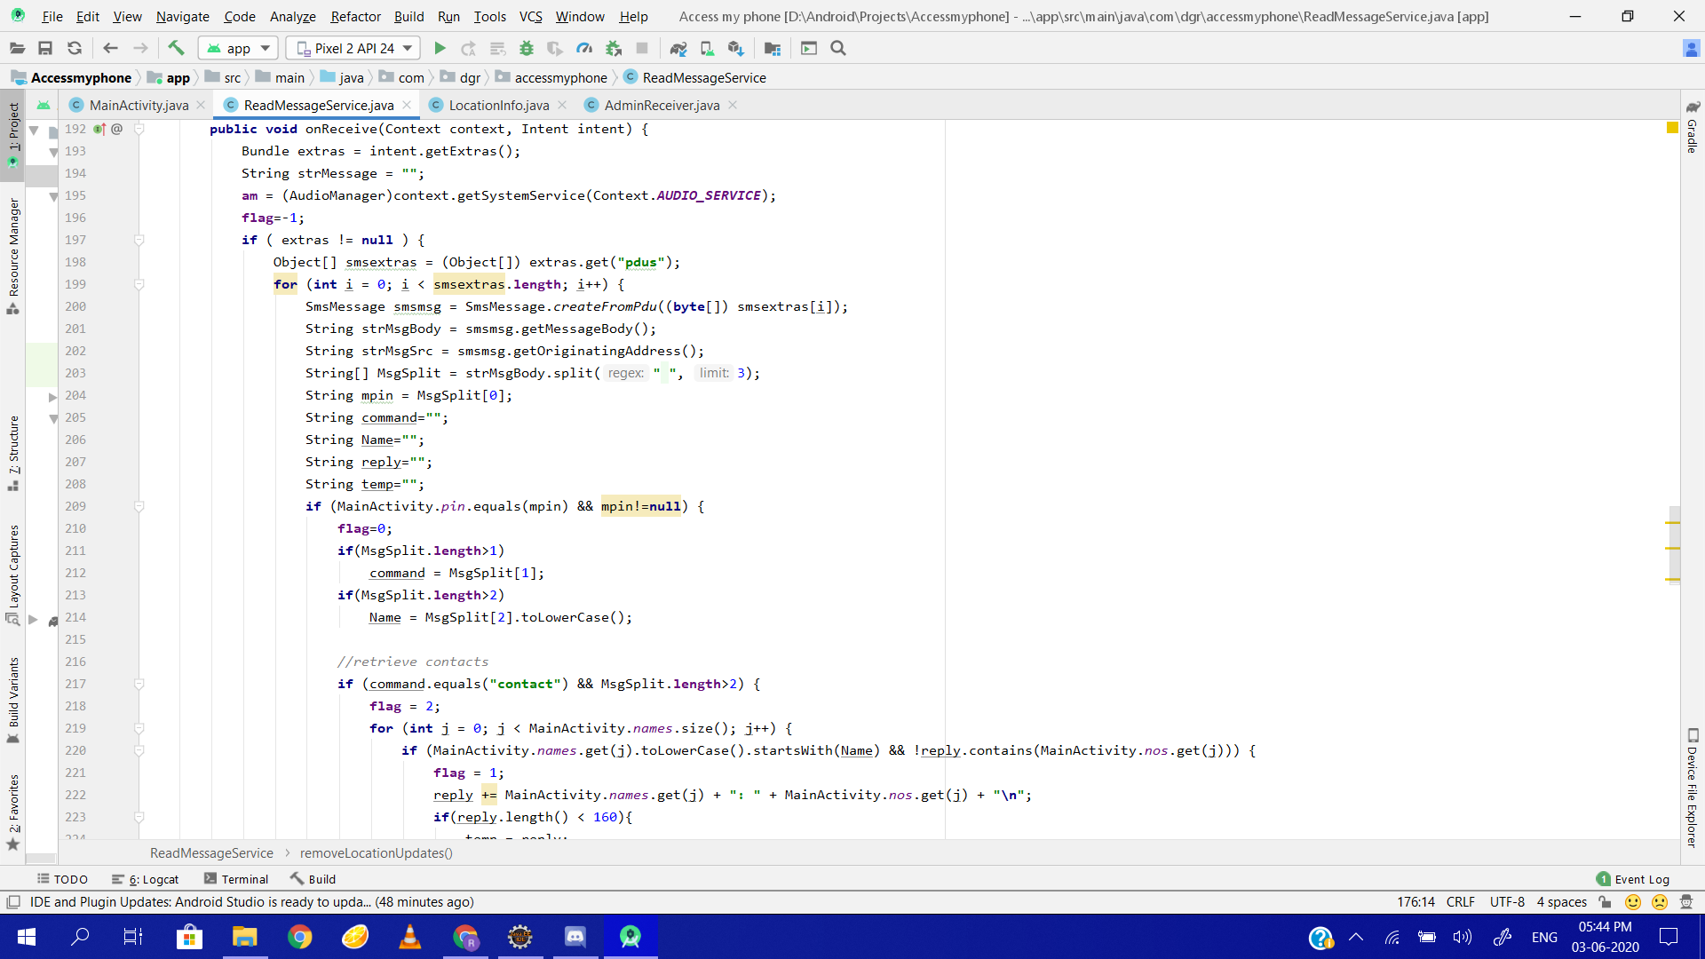
continue...

Slide 28
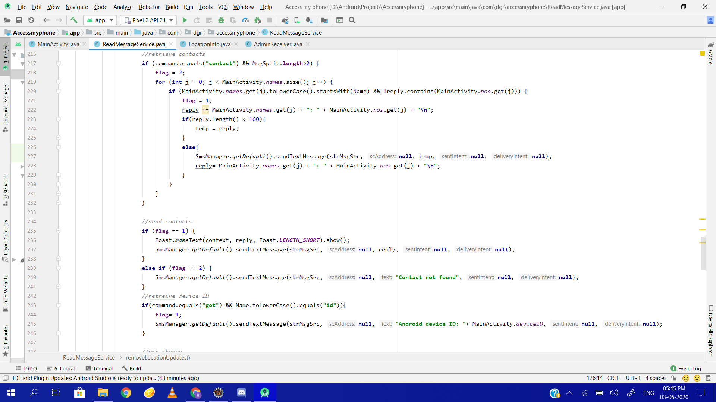
continue...

Slide 29
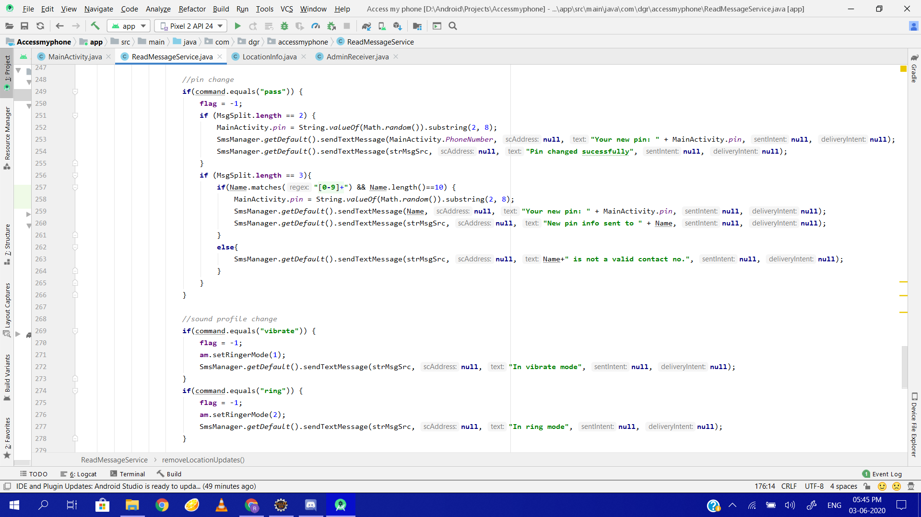
continue...

Slide 30
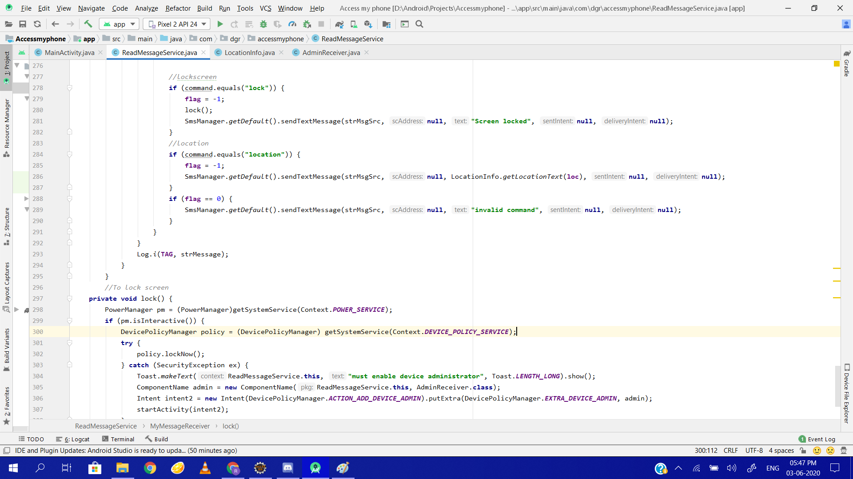
continue...

Slide 31
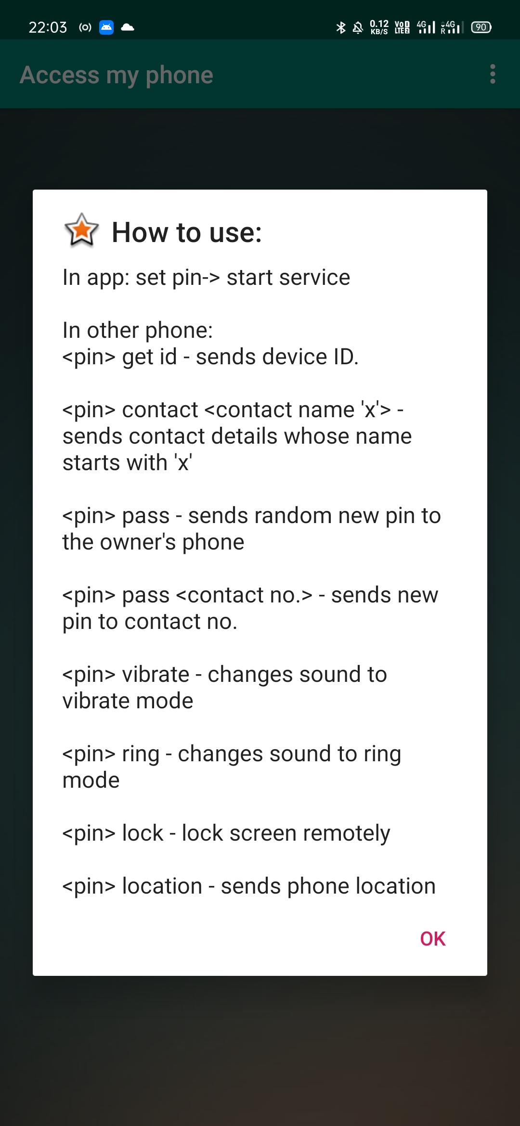
How the App Works…

Slide 32
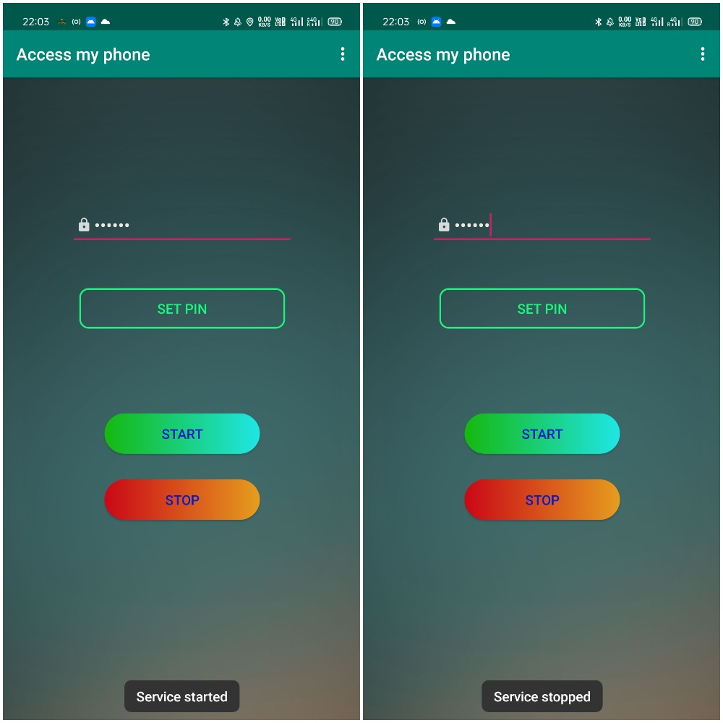
Start/Stop App Service

Slide 33
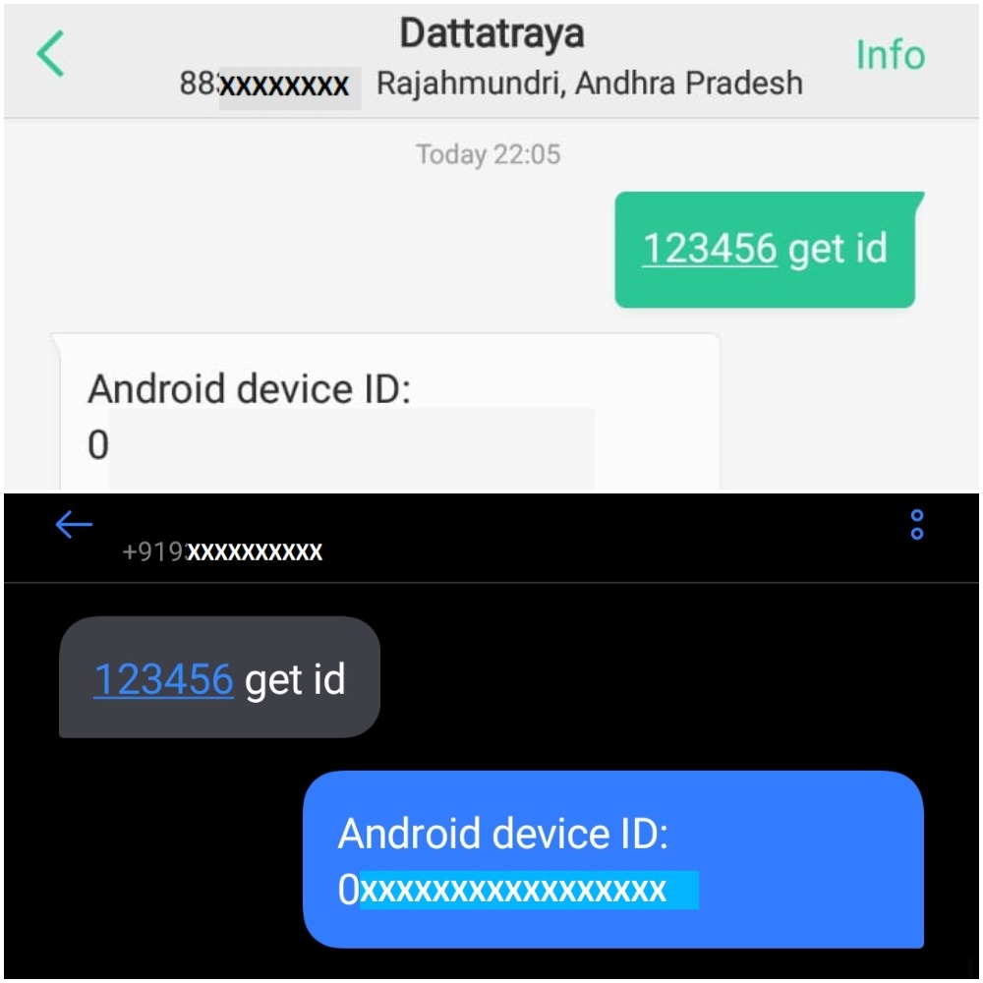
Getting device id

Slide 34
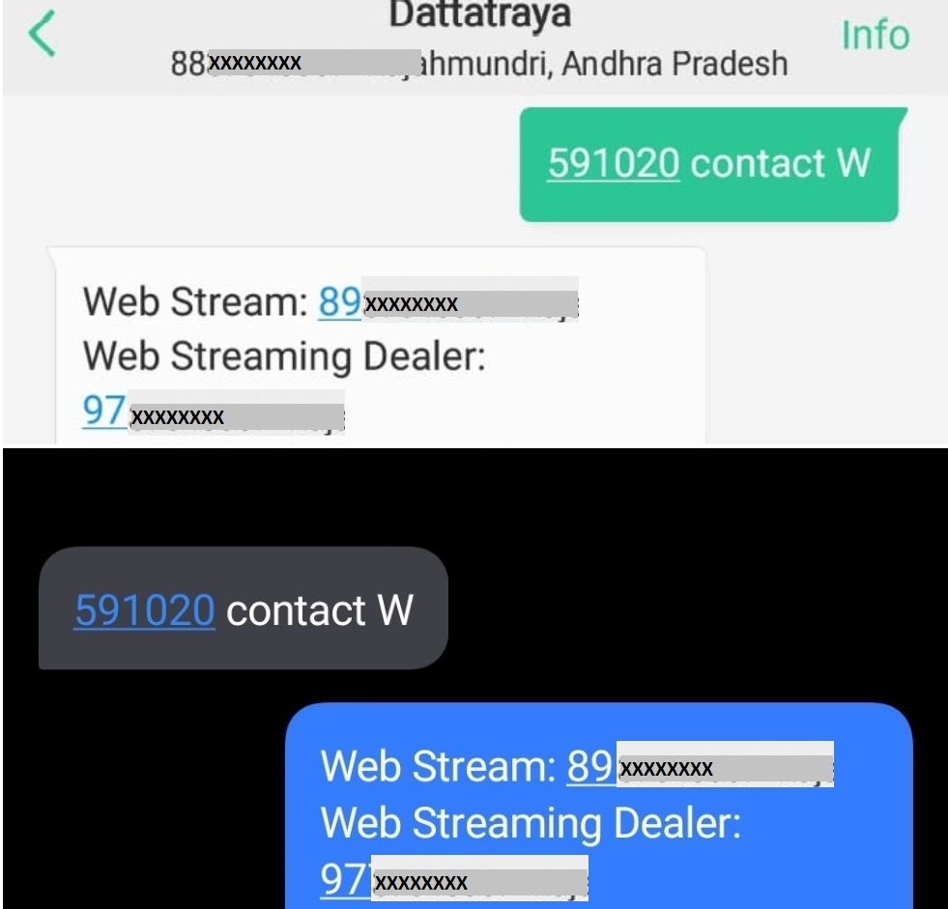
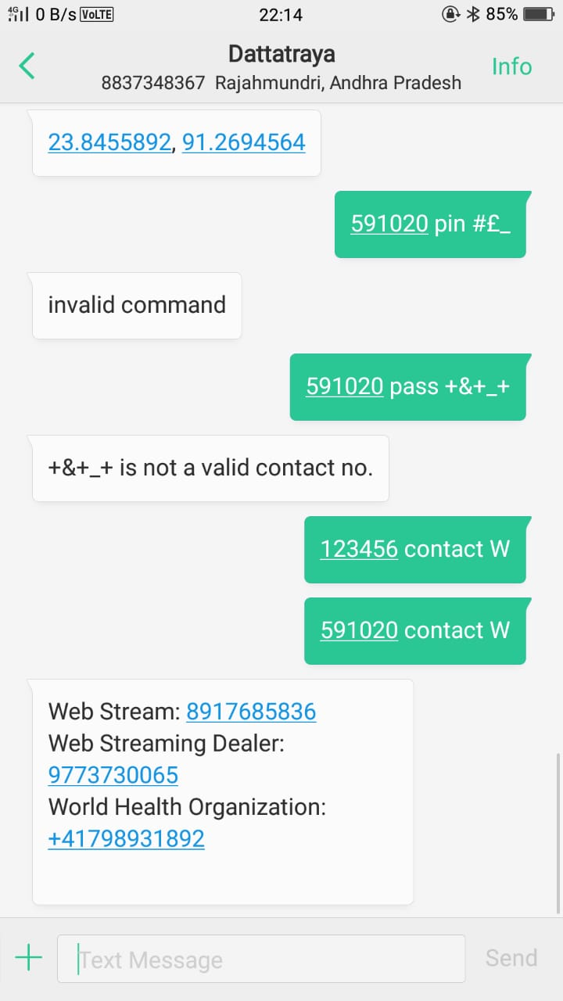
Getting contact detail

Slide 35
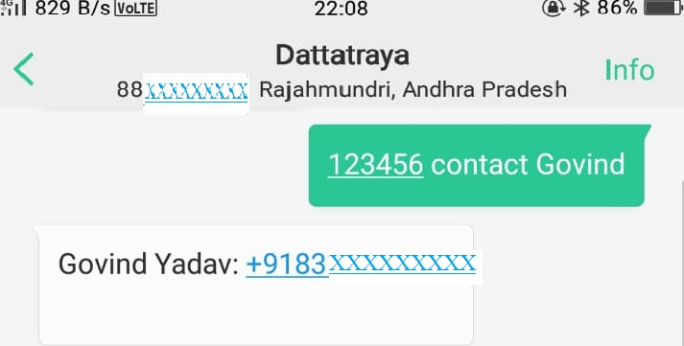
continue...

Slide 36
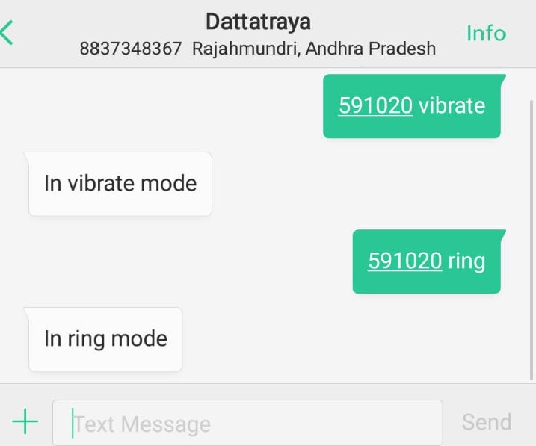
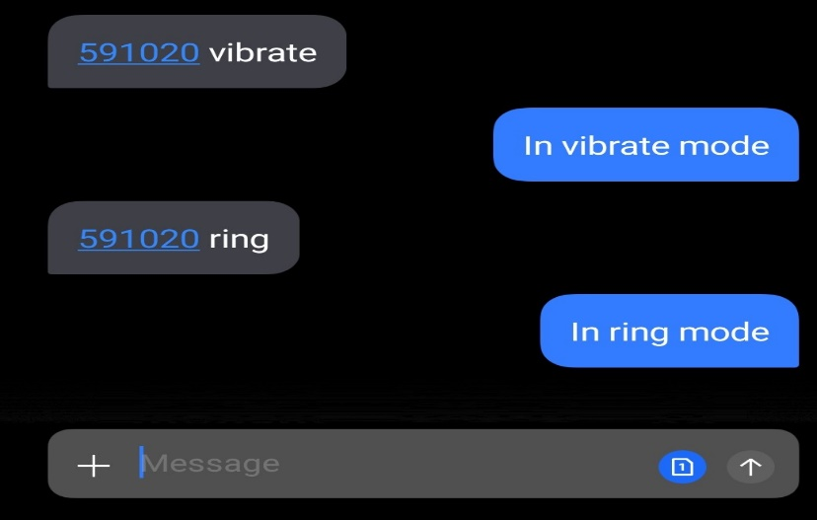
Change device ring/vibrate mode

Slide 37
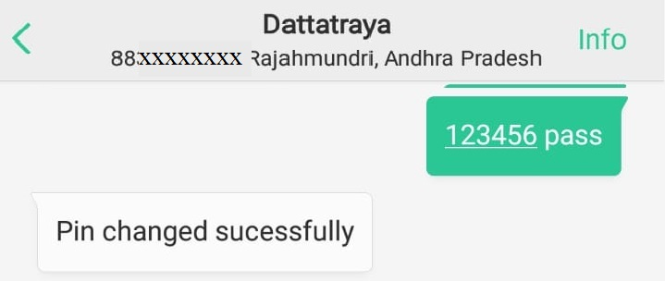
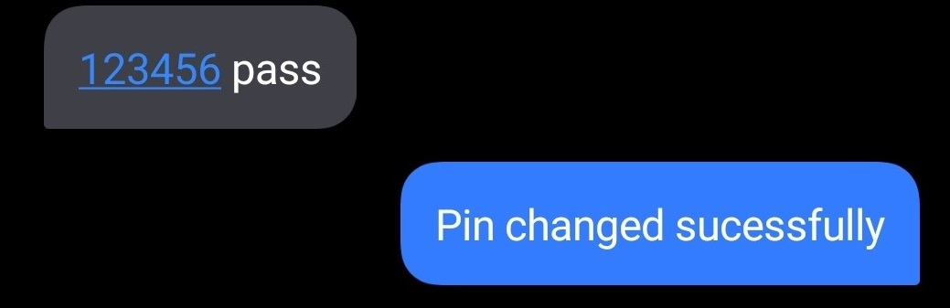
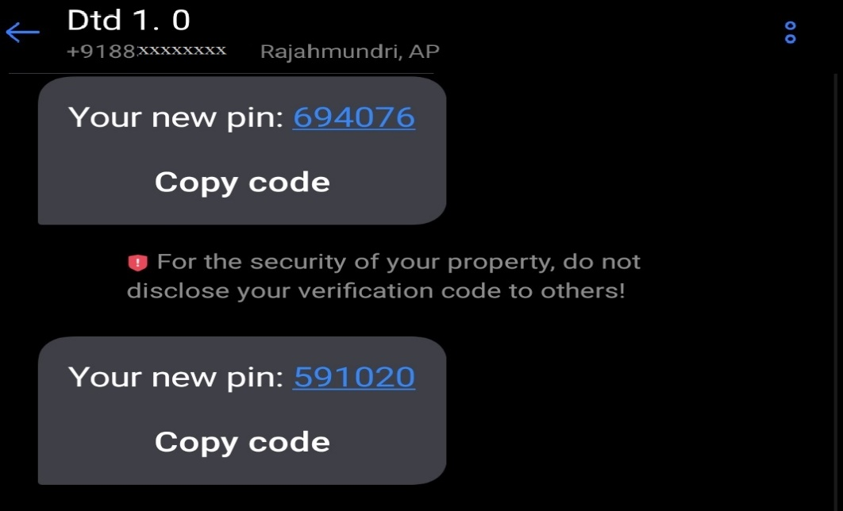
Pin Change(New Random Pin sent to Host Phone

Slide 38
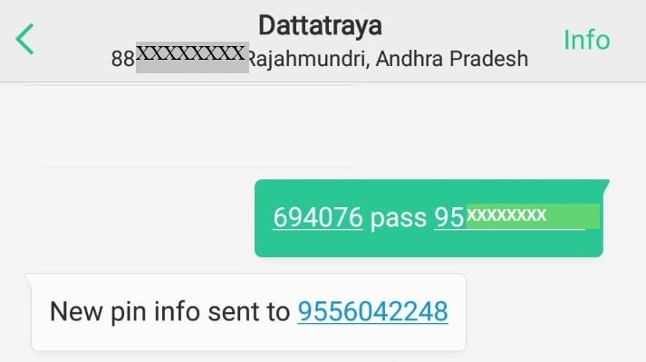
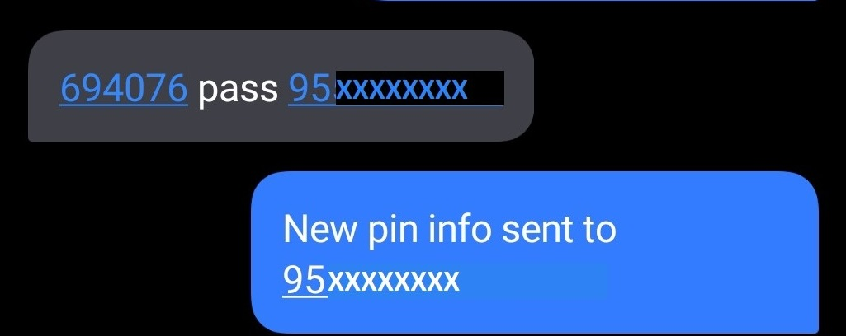
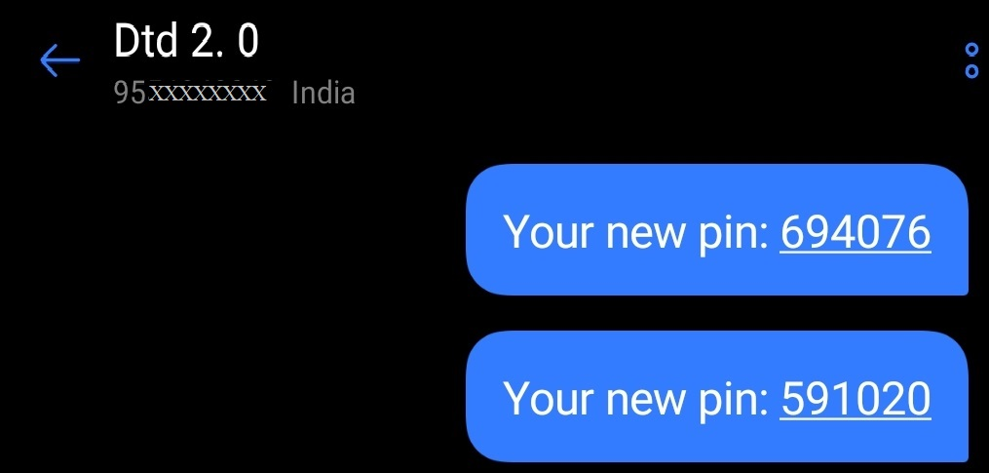
Pin Change(Random Pin sent to Number)

Slide 39
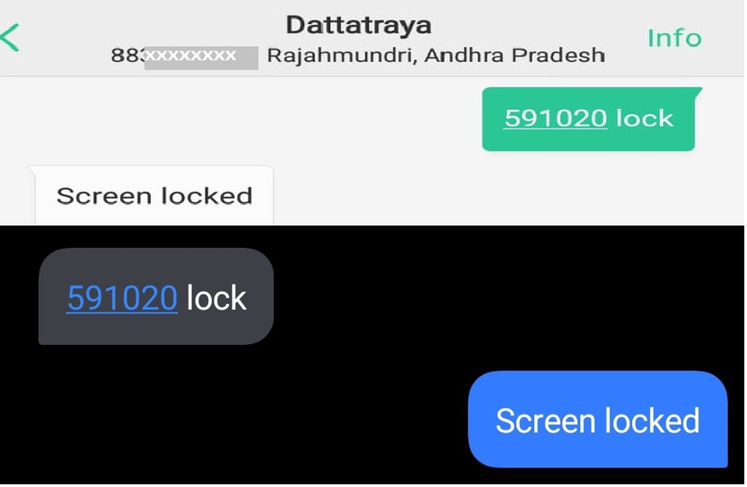
Lock Screen Remotely

Slide 40
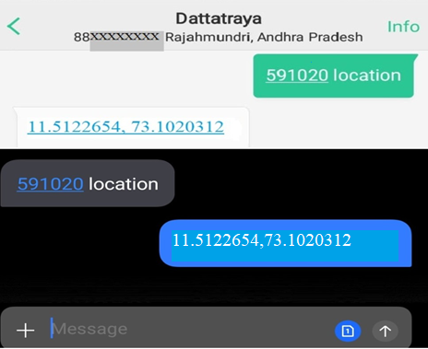
Getting Device Location

Slide 41
Future Scope
We will try to use this app sooner in Smart Watches, Tablets and Other Devices. It can serve us a good tracking Application for the Police Dept.
We will try to add a GPS timer which will send timely device coordinates in certain time intervals.
We will add further more security to the Application like Master Password, Fingerprint Authentication, etc.
We are also focusing to add more functionality in this Application like Disabling/Enabling certain features.
We are also looking forward to add more security applications to it in the future.

Slide 42
CONCLUSION
Phone Tracking and Remote Phone Access Applications are recently rising in Demand now-a days.
It mainly focuses on the safety, security and tracking of Devices.
During times of emergency, we can perform emergency operations remotely from the phone.
This Application can be mainly used by Police Department for Tracking and other Investigation purposes.
Such Applications can save an user’s huge loss of money and sensitive data if he/she gets back access to the Device Again.
Even this app can be a good example for Monitoring system if you don’t have the Device in your nearby vicinity.
This Application is basically a Minor Project made by 4 students under a project Guide from KIIT Deemed to be University, Bhubaneswar for the 6th Semester.
Such Development of Applications are especially focussed on making Human Lifestyle more flexible, efficient and less Effort.
We as Engineers always keeps up the priority to take on such Projects which emphasizes on Eradication of Daily Real Life Problems and thereby take a great step in improving the quality of Human Lifestyle.

Slide 43


